Slide 1
사물인터넷

Slide 2
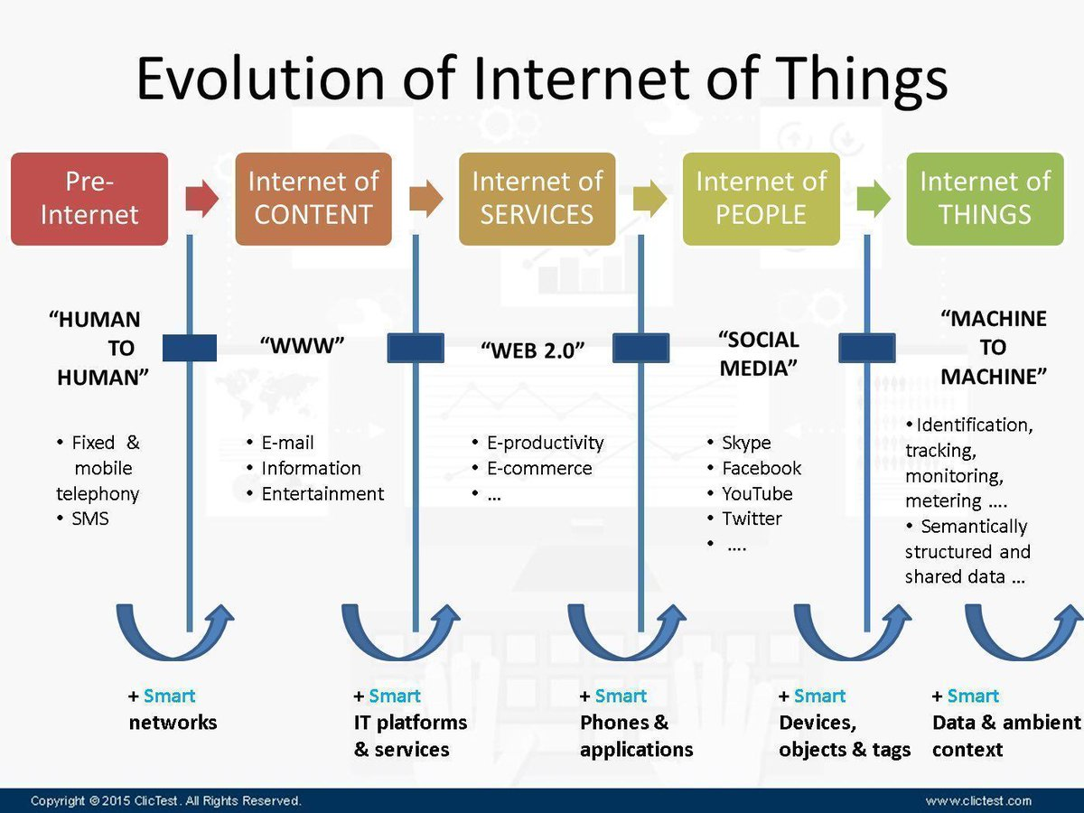

Slide 3
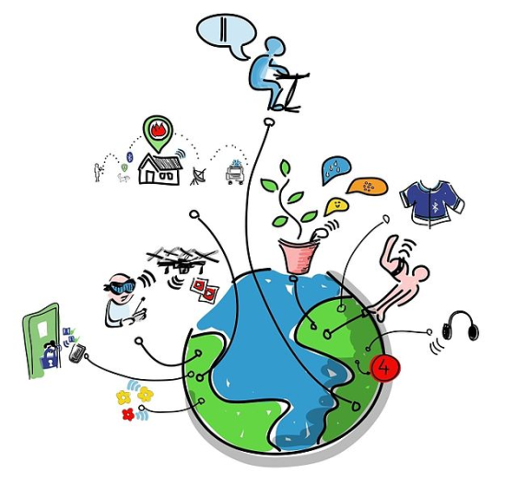
Internet of Things From Wikipedia, the free encyclopedia
the inter-networking of physical devices, vehicles, buildings, and other items embedded with electronics, software, sensors, actuators, and network connectivity which enable these objects to collect and exchange data
will consist of about 30 billion objects by 2020
the global market value of IoT will reach $7.1 trillion by 2020

Slide 6

IoT ?

Slide 7
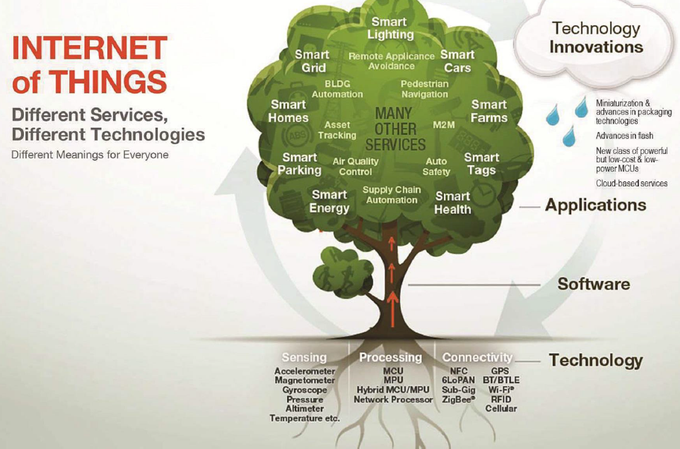

Slide 8
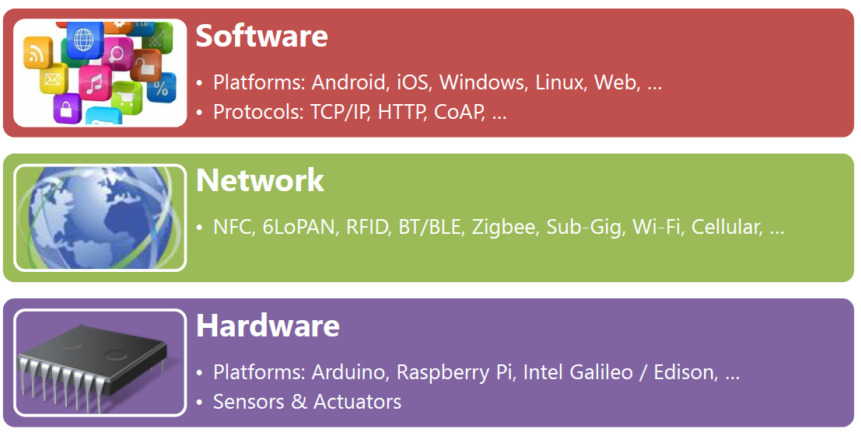

Slide 9
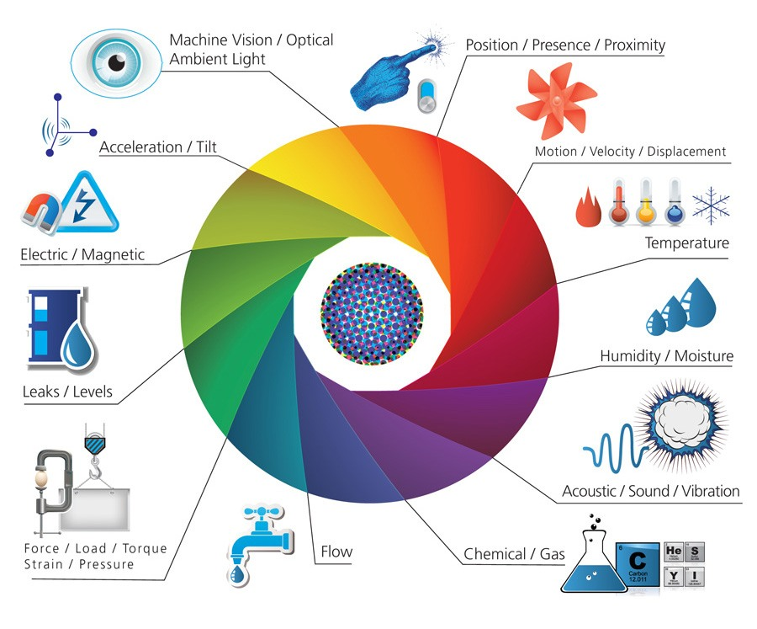
Sensor
Sensor

Slide 10
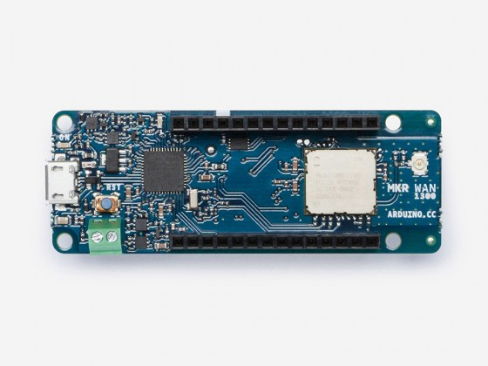
IoT Hardware
https://www.postscapes.com/internet-of-things-hardware/
삼성 ARTIK
https://www.artik.io/
https://www.raspberrypi.org/

Slide 11
IoT Software
https://www.postscapes.com/internet-of-things-software-guide/
https://www.postscapes.com/internet-of-things-platforms/

Slide 12
Top 10 IoT Platforms

Slide 13
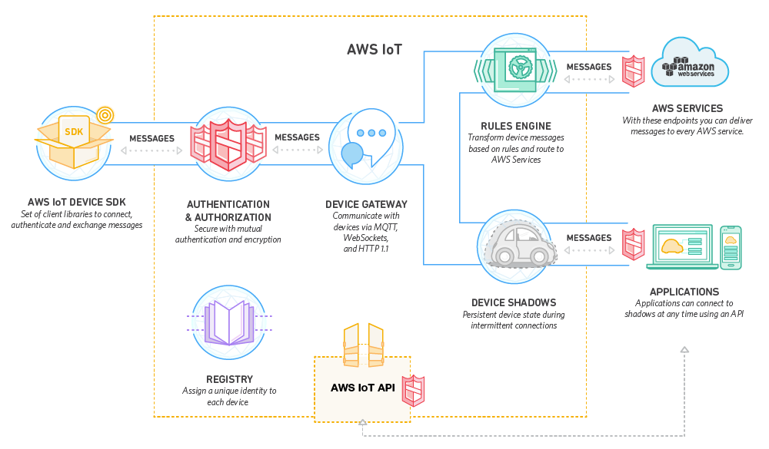

Slide 14
Amazon IoT Platform

Slide 15
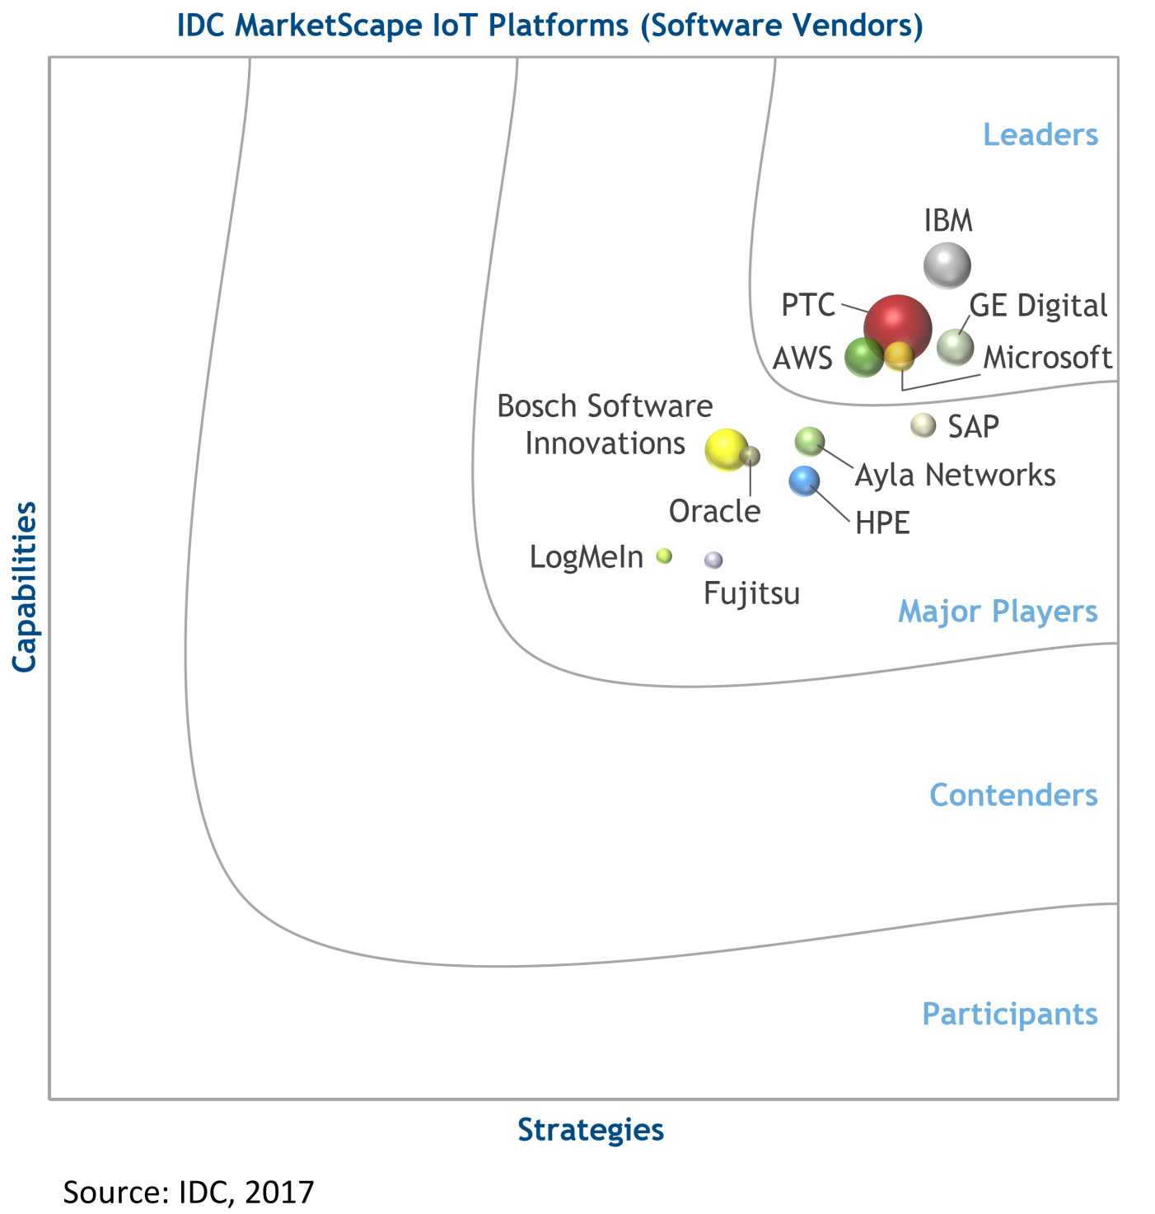

Slide 16
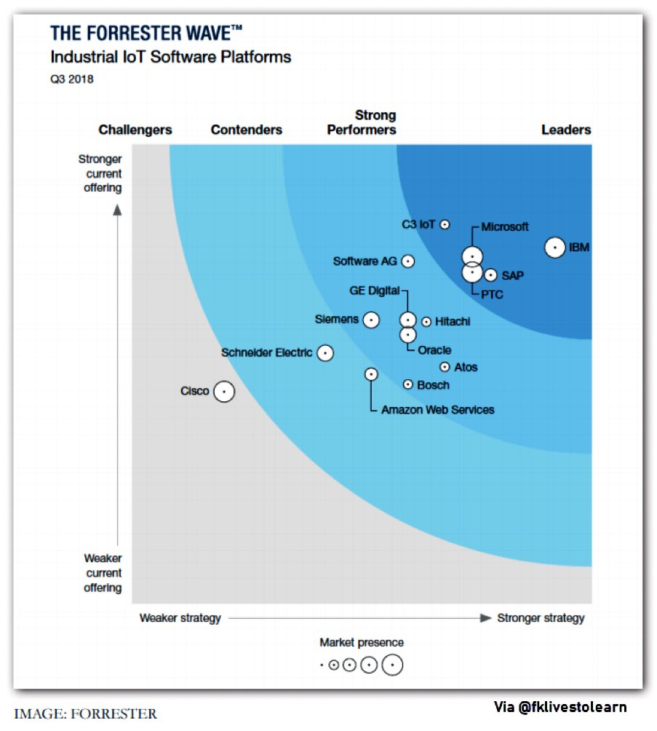

Slide 17
IoT Network
Short-range wireless
Bluetooth
NFC
RFID
6LoPAN
Zigbee
Medium-range wireless
LoRa
LTE-M, 5G
NB-IoT
SIGFOX
https://www.postscapes.com/internet-of-things-protocols/

Slide 19
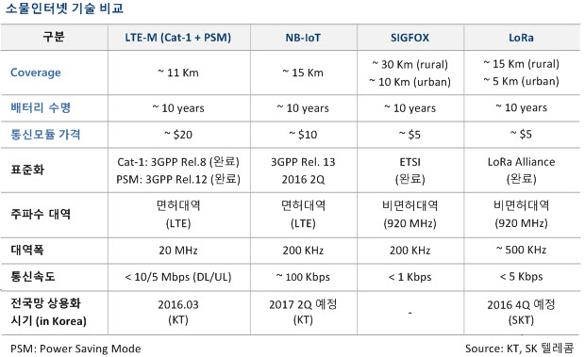

Slide 20
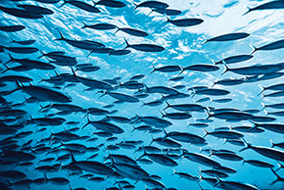
IoT 응용
http://www.libelium.com/resources/top_50_iot_sensor_applications_ranking/

Slide 26
Applications
Media
Environmental monitoring
air or water quality, atmospheric or soil conditions. movements of wildlife. earthquake or tsunami early-warning systems
Infrastructure management
urban and rural infrastructures like bridges, railway tracks, on- and offshore- wind-farms

Slide 27
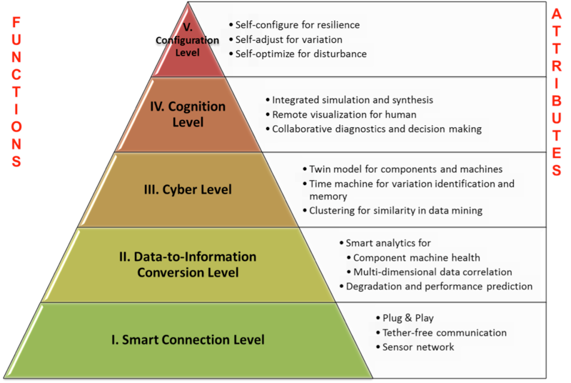
App.
Manufacturing
Network control and management of manufacturing equipment, asset and situation management, or manufacturing process control
IIoT (Industrial Internet of Things), Industry 4.0
IIoT will generate $12 trillion of global GDP by 2030
Predictive and intelligent maintenance

Slide 28
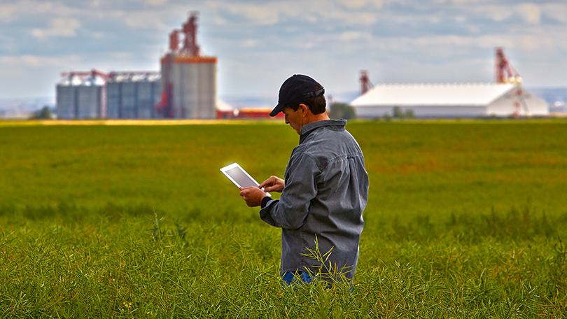

App.
Agriculture
collecting vital information pertaining to the environmental conditions[79][80] - temperature, rainfall, humidity, wind speed, pest infestation, soil humus content or nutrients
field or crop monitoring

Slide 29
App.
Energy management
balance power generation and energy usage
integrated into all forms of energy consuming devices (switches, power outlets, bulbs, televisions, etc.)
Smart Grid
advanced metering infrastructure (AMI) devices

Slide 30
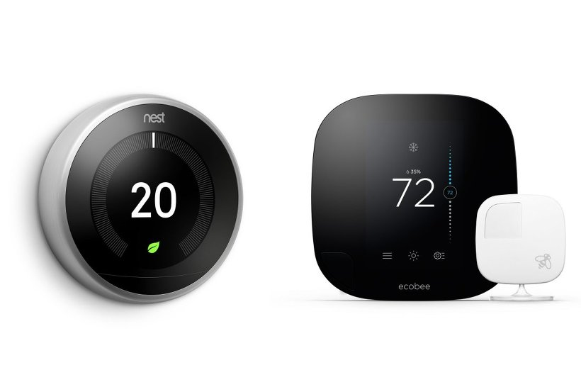
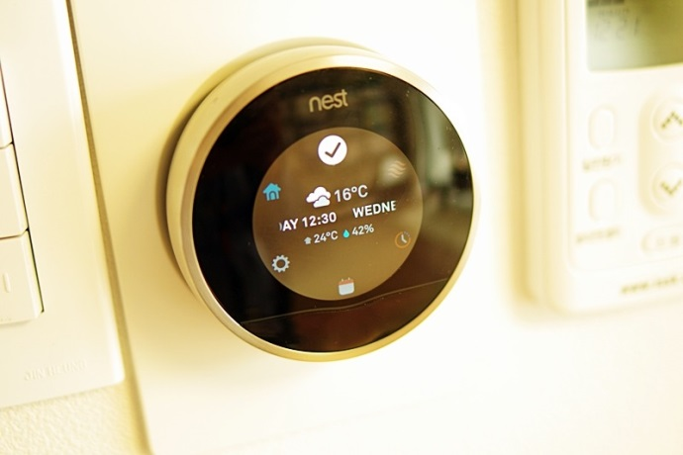
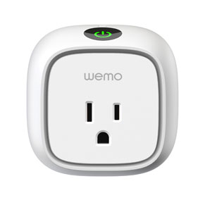
날씨 정보
NEST Echobee3
Wemo from Belkin

Slide 31
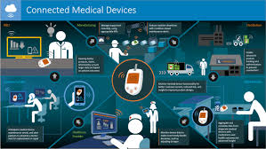
App.
Medical and healthcare
remote health monitoring and emergency notification systems
blood pressure, heart rate monitors, pacemakers, Fitbit electronic wristbands, or advanced hearing aids

Slide 32
App.
Building and home automation
monitor and control the mechanical, electrical and electronic systems used in various types of buildings

Slide 33
App.
Transportation
inter and intra vehicular communication, smart traffic control, smart parking, electronic toll collection systems, logistic and fleet management, vehicle control, and safety and road assistance

Slide 34
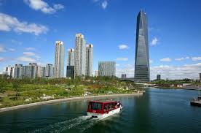
App.
Metropolitan scale deployments
Smart city
Songdo
Santander, Spain
Guangzhou Knowledge City

Slide 35
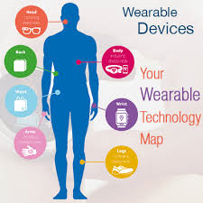
App.
Consumer application
connected car, entertainment, residences and smart homes, wearable technology, quantified self, connected health, and smart retail

Slide 36
IoT 보안
DDos attack using IoT devices
Stealing private/business data
Physical harms
Fire, door, ventilation
Drone, vehicles
Smart factory, hospital, farms
IoT 기기는 저성능이므로 고급 보안기능 구현이 어려움
Authentication
No debug backdoor
Encryption whenever possible
Frequent update
보안에 대한 철저한 인식이 무엇보다 중요

Slide 37
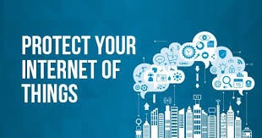
Regulations on IoT
Privacy
Security
Copyright

Slide 38
Issues
Platform fragmentation
Privacy, autonomy, and control
Data storage and analytics
Security
security is the biggest concern in adopting Internet of things technology
Scalability

